Slide 1
Predicting Hypoxemia
Timothy Ruchti, Ph.D.
Director Algorithms
NKUS Lab

Slide 2
Overview
Introduction / Background
What is hypoxemia and why is prediction important?
What is envisioned?
Is there data available to support predictive modeling?
What can we learn from prior research?

Slide 3
Introduction

Slide 4
Nihon Kohden Overview
Founded 1951 in Tokyo, Japan
$1.7 Billion in Sales Globally
US Headquarters in California, 1979
Track Record of Innovation
Top Leading Medical Device Company specializing in Patient Monitoring, Neurology and Cardiology
Fastest Growing Monitoring Company in US
Notes:
Nihon Kohden researcher Takuo Aoyagi envisioned the principle of pulse oximetry. Less than a year after detailing his advancement, the company introduced the world’s first ear oximeter. While pulse oximetry revolutionized patient care, the company decided the technology was too valuable to healthcare to keep to itself. Today, all pulse oximeters are based on Dr. Aoyagi’s breakthrough.

Slide 5
60 year history of innovation
World’s 1st Battery Powered Defibrillator
World’s 1st Early Detection and
Notification System
Worlds 1st Automatic EEG
World’s 1st 192 channel EEG
World’s smallest fully featured transport monitor
World’s 1st SpO2 technology developed
World’s 1st ECG System
1950
1960
1970
1980
1990
2000
2010
World’s 1st 8 Channel EEG with AC Power
World’s 1st 3 Channel Holter ECG Recorder
World’s 1st Wireless EEG
World’s 1st Compact EEG for Transport
Nihon Kohden Founded
Japan’s 1st Central Alarm Monitoring System
World’s 1st arrhythmia analysis
World’s 1st mainstream CO2 sensor for non-intubated patients
Notes:
Nihon Kohden researcher Takuo Aoyagi envisioned the principle of pulse oximetry. Less than a year after detailing his advancement, the company introduced the world’s first ear oximeter. While pulse oximetry revolutionized patient care, the company decided the technology was too valuable to healthcare to keep to itself. Today, all pulse oximeters are based on Dr. Aoyagi’s breakthrough.

Slide 6
Data Platforms and Medical Devices

Slide 7
Alignment with JHU Precision Medicine Initiatives
Data
Patient Monitoring
Neurology
Cardiology
Information
Database
Analytics
Action
Predictive Clinical Support
Notes:
Nihon Kohden's goal is improve the patient and provider experience. We will do this by bring the right person to the right action, quicker, easier or more cost effectively.
To get there, we are taking the data we collect with our data acquisition platforms and combining that data with 3rd party data sources, EMR, other medical devices. The free flow of data into secure, HIPAA compliant database enable the application of advanced analytics to build powerful algorithms. The data turns into information. When presented to the right person at the right time, drives action that improves patient outcomes.

Slide 8
The application development process
Potential &
Enthusiasm
Significant Effort
Research Environment
Collaborate
Gather information
Create data sets
Identify opportunity
Define use cases
Clinical Environment
Computational Environment
Application Environment
Most Reported Work Ends Here
Underestimated
Challenge
Integrate workflow
Deploy model
Build/Validate
Models
Adapted From: Dreyer, K and J.R. Geis, When Machines Think: Radiology’s Next Frontier, Radiology, Vol 285, No 4, Dec. 2017

Slide 9






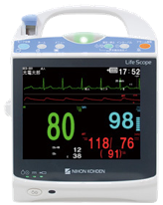

Data Platform – High Level View
Gateway
Data Platform
Analytics Platform
Analytics and Reporting
AI
Analytical
Application
Development
Alerts, Insight and Results to Point of Care
Sepsis
Sepsis
Apps
Application Deployment
(Customer & NK)
Hypoxemia

Slide 10
Hypoxemia

Slide 11
Hypoxemia in Critical Care
Hypoxemia in critical care patients is both frequent and independently associated with higher mortality. In a recent multi-center study¹, over 50% of ICU patients experienced hypoxemia and had double the length of stay versus non-hypoxemic patients.
*SRLF Trial Group. "Hypoxemia in the ICU: prevalence, treatment, and outcome." Annals of intensive care 8, no. 1 (2018): 82.

Slide 12
What is hypoxemia?
Hypoxemia = low blood oxygen levels
Blood oxygen levels do not support proper physiological system functioning and can lead to deterioration (i.e., heart/brain)
Non-specific indicator of disease/deterioration
Hypoxemia can lead to hypoxia, inadequate tissue and/or organ oxygen levels
Common Symptoms
Confusion
Rapid Breathing
Shortness of Breath
Diaphoresis
Slow/Fast Heart Rate

Slide 13
Hypoxemia is Prevalent
2018 SPECTRUM Study: 1604 Patients, 117 ICUs, 7 French speaking countries [1]
Over 50% of subjects were hypoxemic
51% Mild
40% Moderate
9% Severe
Found hypoxemia is prevalent in non-ventilated patients and in those not meeting the requirements for ARDS
SRLF Trial Group. "Hypoxemia in the ICU: prevalence, treatment, and outcome." Annals of intensive care 8, no. 1 (2018): 82.

Slide 14
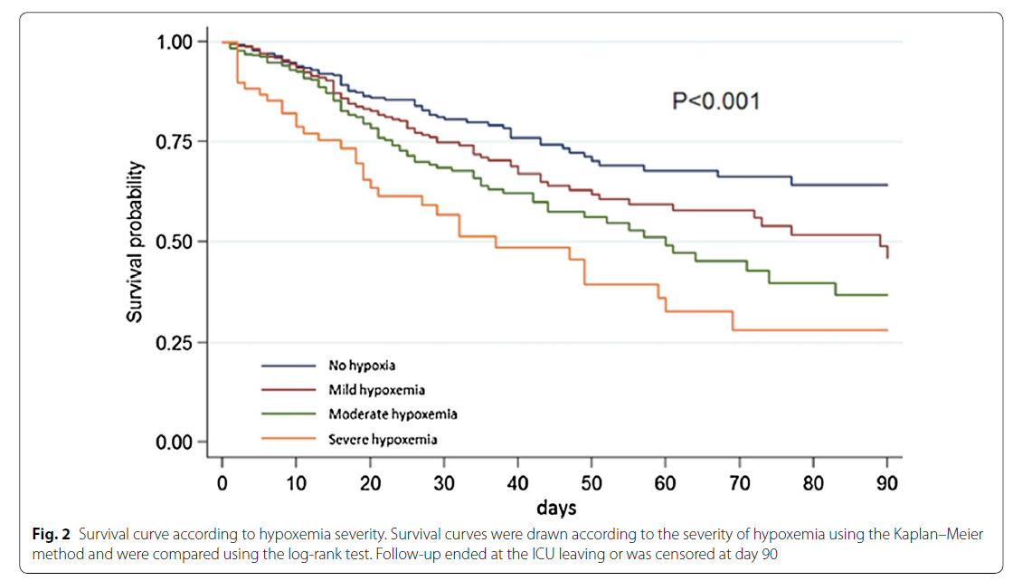
Hypoxemia is Dangerous
Length of stay doubles
Risk of mortality more than doubled (27% vs 11%)
Severity correlated with survival probability
Hypoxemia is an independent predictor of mortality
SRLF Trial Group. "Hypoxemia in the ICU: prevalence, treatment, and outcome." Annals of intensive care 8, no. 1 (2018): 82.

Slide 15
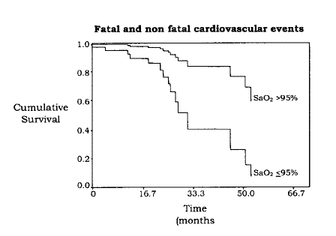
Nocturnal Hypoxemia == Complications
A 1% decrease in average nocturnal SaO₂ (due to apnea) was associated with a 33% increase in the incident risk of cardiovascular events in dialysis patients
Zoccali, Carmine, Francesca Mallamaci, and Giovanni Tripepi. "Nocturnal hypoxemia predicts incident cardiovascular complications in dialysis patients." Journal of the American Society of Nephrology 13, no. 3 (2002): 729-733.

Slide 16
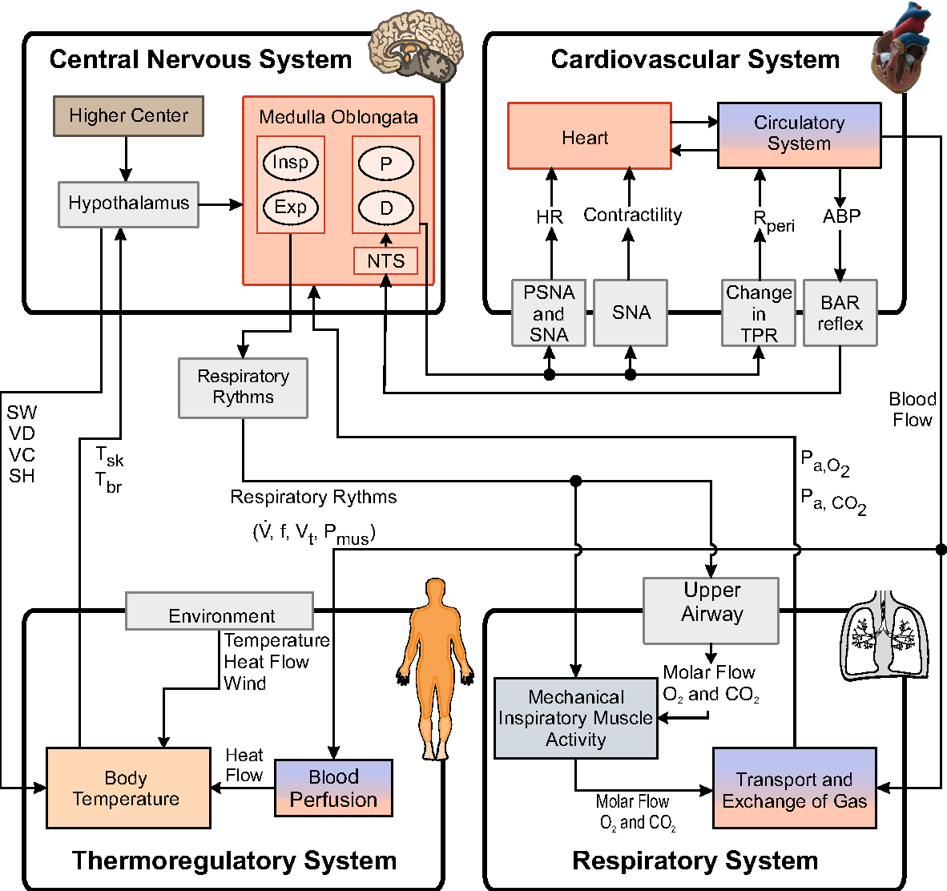
What are causes of hypoxemia?
Oxygen transport through the body occurs through convection and diffusion. Consequently, any disease state that interferes with either process may produce hypoxemia.
Observed Mechanisms/Causes [1]:
Pneumonia
Fluid Overload
Pleural Effusion
Atelectasis
Acute Chronic Respiratory Failure
Shock
Aspiration
Cardiogenic Pulmonary Edema
Pulmonary Embolism
Thoracic Trauma
Pneumothorax
Acute Pancreatitis
1SRLF Trial Group. "Hypoxemia in the ICU: prevalence, treatment, and outcome." Annals of intensive care 8, no. 1 (2018): 82.
2 Image: Heinke, Stefanie, Carina B. Pereira, Steffen Leonhardt and Marian Walter. “Modeling a healthy and a person with heart failure conditions using the object-oriented modeling environment Dymola.” Medical & Biological Engineering & Computing 53 (2015): 1049-1068.

Slide 17
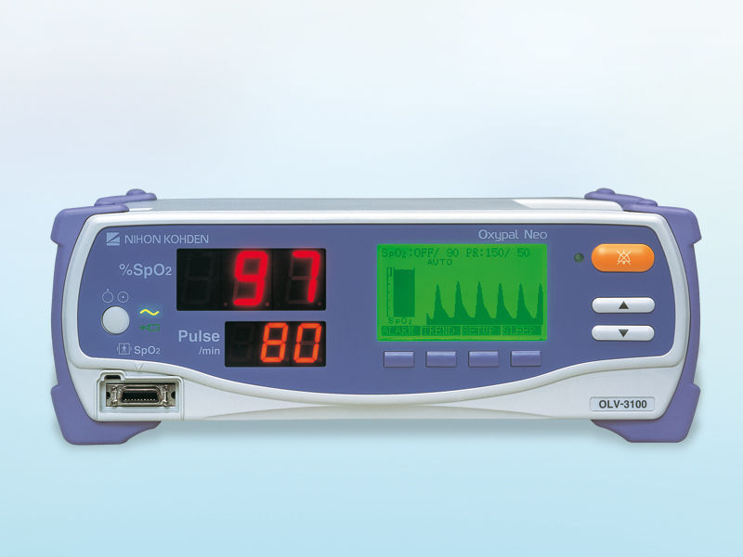
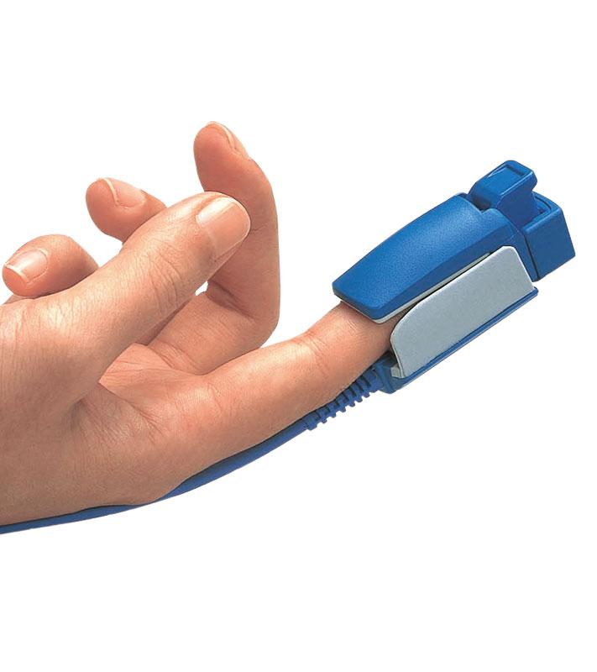
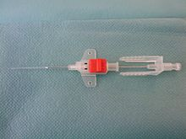
Hypoxemia is Easily Detected
Arterial Blood Gas Analysis
Pulse Oximetry
Episodic, invasive measurement of PaO₂ (partial pressure of oxygen blood)
Continuous, non-invasive measurement of SpO₂
(peripheral capillary oxygen saturation)
Determines hypoxemia (i.e., <75 mmHg)
Estimates hypoxemia (i.e., <95% saturation)
Detection = Adverse Event Underway

Slide 18
Prediction of Hypoxemia for early detection of deterioration

Slide 19
Project Problem Statement
Hypoxemia frequently precedes diagnosis of other (severe) deleterious conditions
Despite its prevalence and current monitoring capability, few studies have been reported which provide predictive information in support prophylactic intervention
We hypothesize that commonly recorded time series data (in combination with contextual variables) can be used to predict the probability of future sustained hypoxemia and thereby enable intervention prior to the acute and potentially harmful condition. Further, this predictive indicator with other contextual measurements may provide more specific information regarding the nature of patient decline.

Slide 20
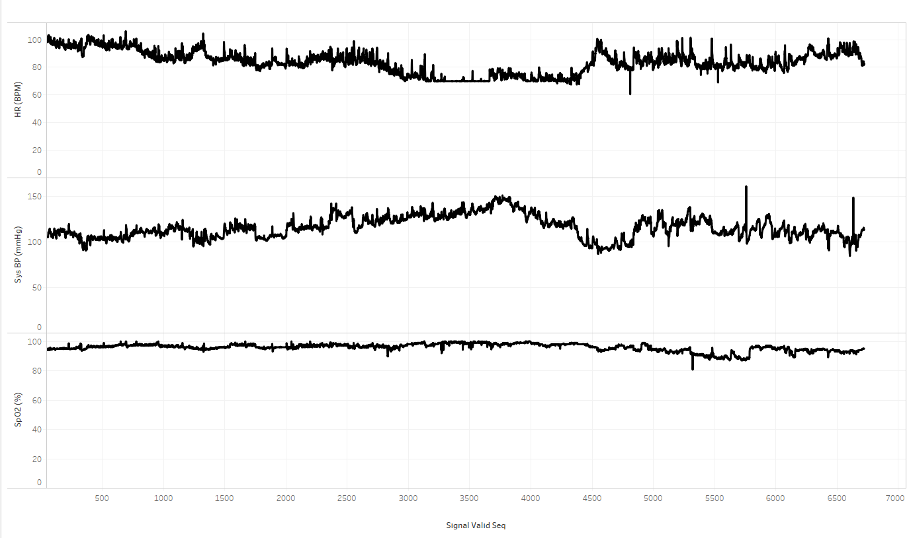
Envisioned Solution
High Fidelity Commonly Measured Time Series Data
(1 sec to 1 min intervals)
Other Data Sources
(Labs, ADT, Inputs)
Hypoxemia
Prediction
Probability/ Likelihood
Trend
Insight
Predictive
Model
Artifact Rejection
Signal Processing
Feature Extraction

Slide 21
Feasibility?
Is there adequate data?
Does prior research support hypoxemia prediction and what can we learn from published studies?
How will a hypoxemia prediction system fit into clinical workflows such that outcomes are improved? (not addressed in the proposal)

Slide 22
Adequate Data? MIMIC III
MIMIC-III (‘Medical Information Mart for Intensive Care’) is a large, single-center database comprising information relating to patients admitted to critical care units at a large tertiary care hospital.
Data includes vital signs, waveforms, medications, laboratory measurements, observations and notes charted by care providers, fluid balance, procedure codes, diagnostic codes, imaging reports, hospital length of stay, survival data, and more.
Diagnostic classification codes (ICD-9) are generated at the end of hospital visits for billing purposes. MIMIC III includes this information collected from the hospital record system.
Source: Johnson, Alistair EW, Tom J. Pollard, Lu Shen, H. Lehman Li-wei, Mengling Feng, Mohammad Ghassemi, Benjamin Moody, Peter Szolovits, Leo Anthony Celi, and Roger G. Mark. "MIMIC-III, a freely accessible critical care database." Scientific data 3 (2016): 160035.

Slide 23
What is the prevalence of hypoxemia in ICD-9 DB?
ICD-9 Codes
ICD-9 Description
Table
Subject ID
How many entries (hospital stays) per code?
How many unique Subject IDs per code?

Slide 24
ICD-9 Code Analysis
Amount of data appears supportive!

Slide 25
Next Steps
Within the MIMIC III data set, hypoxemia was diagnosed as indicated by ICD9 codes 1298 times in 1235 unique patients.
There are likely many more instances of hypoxemia that can be determined on the basis of a standard definition via inspection of routinely measured vital signs - 50% of patients in the SPECTRUM study experienced hypoxemia.
The data set must further be analyzed to identify data collected outside of surgical procedures as well as the integration of information related to interventions (i.e., patients receiving oxygen, ventilated, etc.).

Slide 26
Cleaning and Labeling the Data
Definitions:
What constitutes an event
Erroneous data and outlier identification
Subject Inclusion/Exclusion Criteria
Identification of variables and their sources
Ideally, time series data collected at frequent intervals (at least 1/min)
Directly from monitors: 1 Hz
Determination of target subject population in MIMIC
Data Extraction
Cleaning/Filtering/etc
Labeling
Training
Set
Used for Modeling
Mon.
Set
Used for Modeling Decisions
Test
Set
Independent set
of unique patients
Set aside for final
evaluation

Slide 27

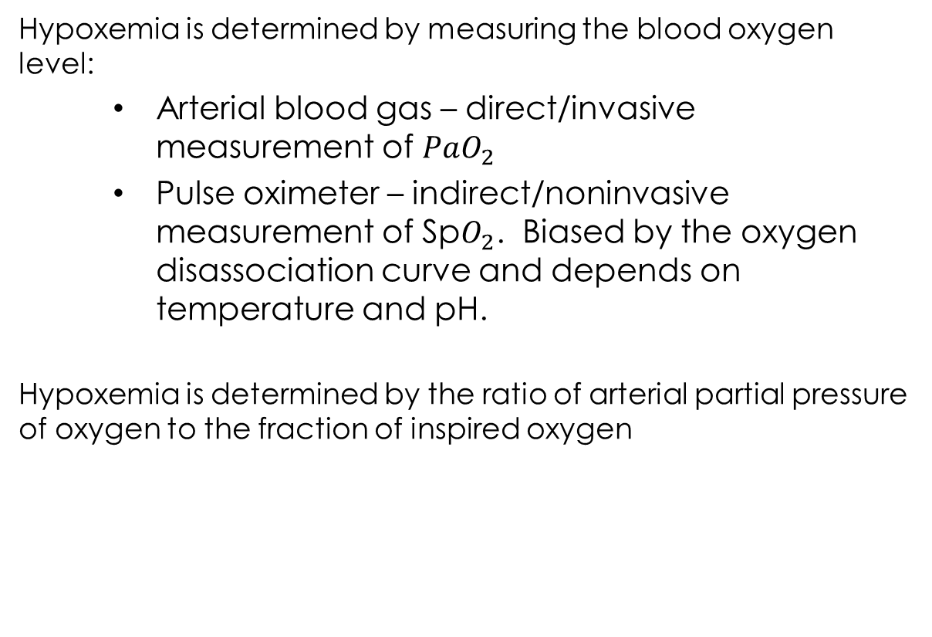
Hypoxemia Definitions for Labeling
Hypoxemia is determined by measuring the blood oxygen level:
Arterial blood gas – direct/invasive measurement of $PaO_{2}$
Pulse oximeter – indirect/noninvasive measurement of Sp$O_{2}$. Biased by the oxygen disassociation curve and depends on temperature and pH.
Hypoxemia is determined by the ratio of arterial partial pressure of oxygen to the fraction of inspired oxygen
In the SPECTRUM study, 40% of hypoxemic patients were detected/managed via SpO₂ measurements
$${PaO_{2} }/{FiO_{2} }$$
Problem: not always available or timely

Slide 28
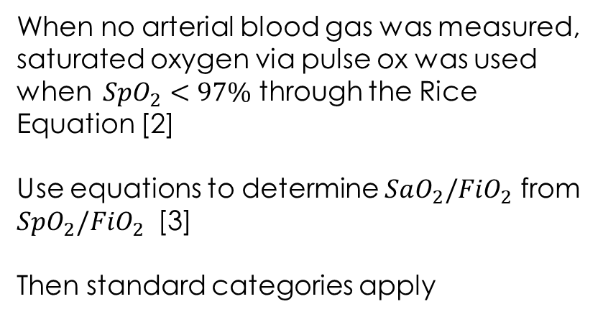
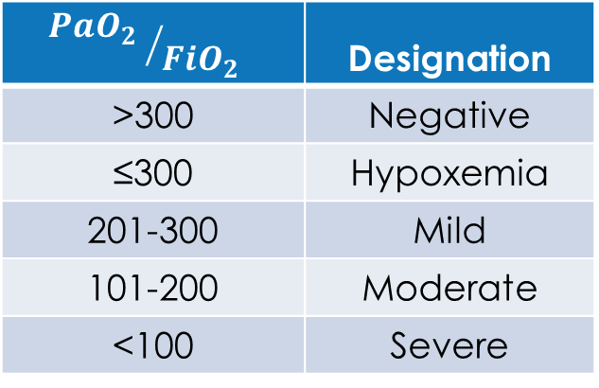
SPECTRUM Study Labeling ExampleHypoxemia
Blood Gas Measurement Available
Only Pulse Oximeter Available
$${PaO_{2} }/{FiO_{2} }$$ | Designation
>300 | Negative
≤300 | Hypoxemia
201-300 | Mild
101-200 | Moderate
<100 | Severe
When no arterial blood gas was measured, saturated oxygen via pulse ox was used when $SpO_{2}<97\%$ through the Rice Equation [2]
Use equations to determine $SaO_{2}/FiO_{2}$ from $SpO_{2}/FiO_{2}$ [3]
Then standard categories apply
$$FiO_{2}≈0.21+(0.03 ×oxygen flow rate l/min)$$
1 SRLF Trial Group. "Hypoxemia in the ICU: prevalence, treatment, and outcome." Annals of intensive care 8, no. 1 (2018): 82.
2 Rice TW, Wheeler AP, Bernard GR, Hayden DL, Schoenfeld DA, Ware LB. Comparison of the SpO2/FiO2 ratio and the PaO2/FiO2 ratio in patients with acute lung injury or ARDS. Chest. 2007;132(2):410–7.
3 Brown SM, Grissom CK, Moss M, et al. Nonlinear Imputation of Pao2/Fio2 From Spo2/Fio2 Among Patients With Acute Respiratory Distress Syndrome. Chest. 2016;150(2):307–313. doi:10.1016/j.chest.2016.01.003

Slide 29
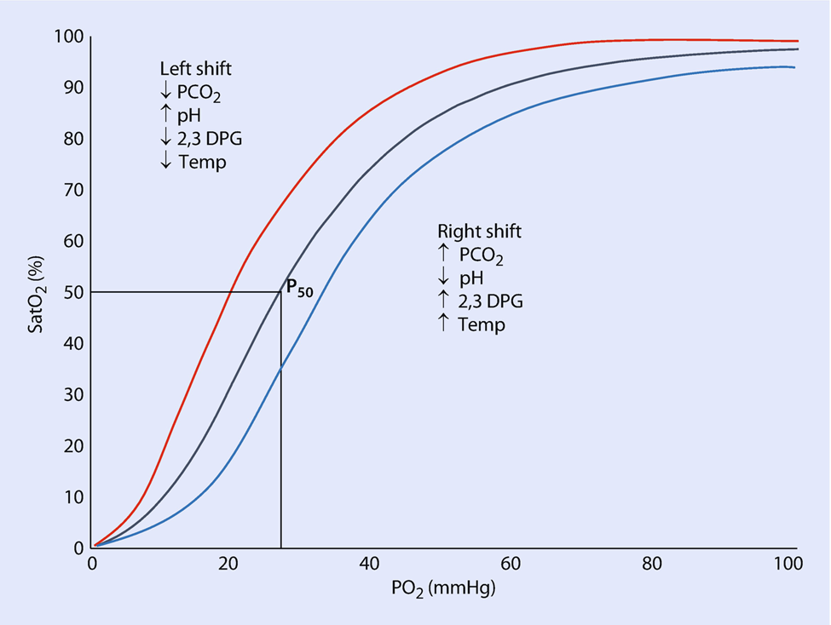
Note on Blood Oxygen Measures
Oxygenated Blood Leaving the Lungs
Oxygenated
Hemoglobin
SpO₂ (%)
Oxygen Saturation
Returning from tissue
Oxygen Partial Pressure
Oxygen Dissolved in the Blood PaO₂ (mmHg)
Image adapted from Duscio E., Vasques F., Romitti F., Cipulli F., Gattinoni L. (2019) Oxygen Delivery. In: Pinsky M., Teboul JL., Vincent JL. (eds) Hemodynamic Monitoring. Lessons from the ICU (Under the Auspices of the European Society of Intensive Care Medicine). Springer, Cham

Slide 30
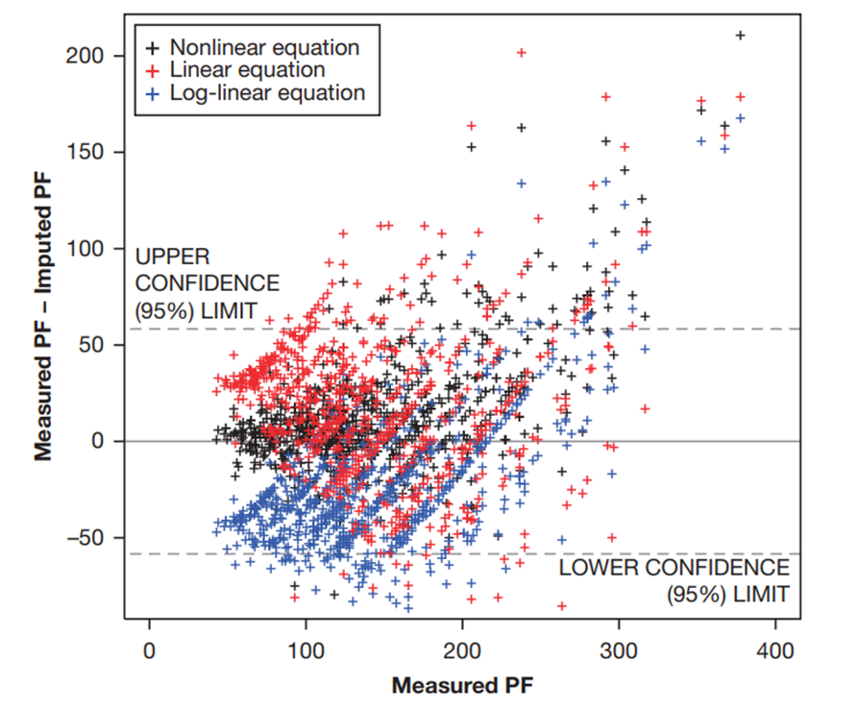
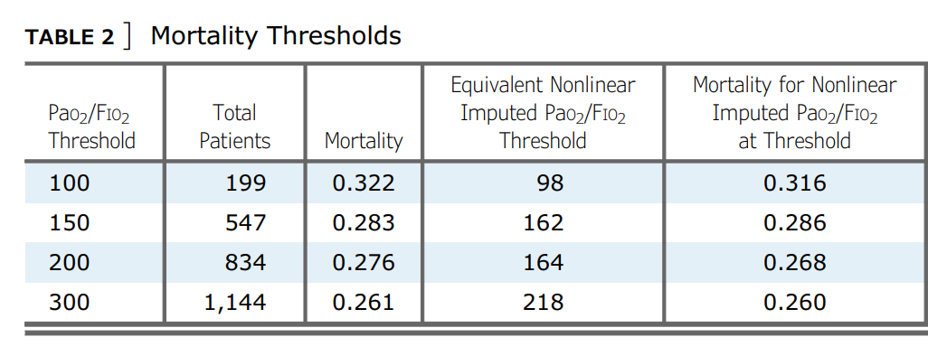
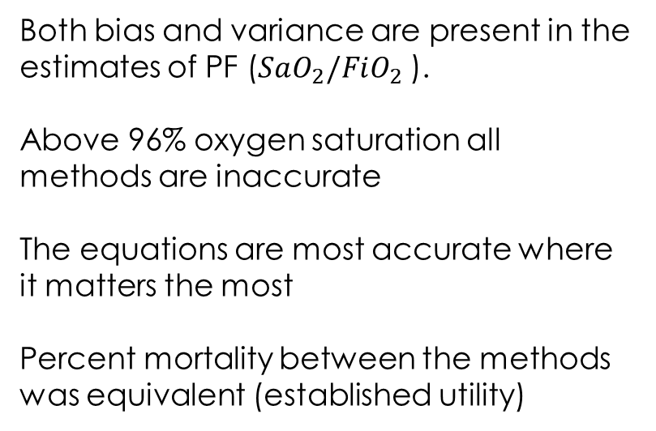
Detecting Hypoxemia via SpO₂
Both bias and variance are present in the estimates of PF ($SaO_{2}/FiO_{2}$ ).
Above 96% oxygen saturation all methods are inaccurate
The equations are most accurate where it matters the most
Percent mortality between the methods was equivalent (established utility)
Brown SM, Grissom CK, Moss M, et al. Nonlinear Imputation of Pao2/Fio2 From Spo2/Fio2 Among Patients With Acute Respiratory Distress Syndrome. Chest. 2016;150(2):307–313. doi:10.1016/j.chest.2016.01.003

Slide 31
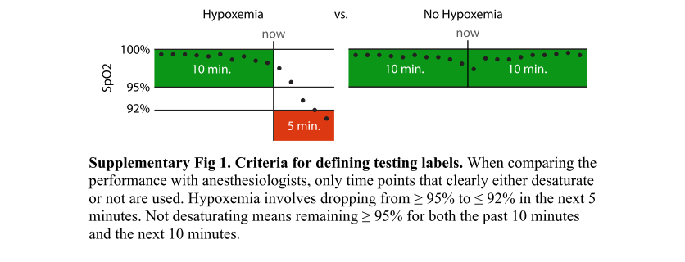
Labeling Example
Automatic Labeling – Ensures Clear Drops for Reference Data
From Supplementary Materials: Lundberg, Scott M., Bala Nair, Monica S. Vavilala, Mayumi Horibe, Michael J. Eisses, Trevor Adams, David E. Liston et al. "Explainable machine-learning predictions for the prevention of hypoxaemia during surgery." Nature biomedical engineering 2, no. 10 (2018): 749.

Slide 32
Example (MIMIC II) Time Series Data
HR
Systolic Blood Pressure
SpO2
Labeled instance of hypoxemia
Conceptual hypoxemia probability index
1
Alert
0

Slide 33
Prior Research Shows Feasibility & Opportunity
Anesthesiologist implicitly predict hypoxemia and take action before it happens -- use patient context, meds, vital signs, trends
University of Washington – developed “prescience” to predict hypoxemia during surgery (ventilated, under anesthesia) [1]
Important contribution
Prediction feasible
Adds methods to explain predictions regardless of model complexity
Key differences:
Prior work utilizes ventilated patients under general anesthesia during surgery. We would like to monitor any critical care patient and use commonly available signals.
Prior delivers predictions with a 5 minute ahead horizon. This may not be adequate for a patient who is not under constant anesthesiologist watch.
1 Lundberg, Scott M., Bala Nair, Monica S. Vavilala, Mayumi Horibe, Michael J. Eisses, Trevor Adams, David E. Liston et al. "Explainable machine-learning predictions for the prevention of hypoxaemia during surgery." Nature biomedical engineering 2, no. 10 (2018): 749.

Slide 34
5 Min Ahead Prediction Performance vs Human Panel
Independent Test Set
523 test cases
AUC Anesthesiologists: 0.66
AUC Predictive Model: 0.81
Given the same information, the machine learning model provides improved prediction performance vs a panel of anesthesiologists.
1 Lundberg, Scott M., Bala Nair, Monica S. Vavilala, Mayumi Horibe, Michael J. Eisses, Trevor Adams, David E. Liston et al. "Explainable machine-learning predictions for the prevention of hypoxaemia during surgery." Nature biomedical engineering 2, no. 10 (2018): 749.

Slide 35
What variables supported hypoxemia prediction?
What if only SpO2 was used?
1 Lundberg, Scott M., Bala Nair, Monica S. Vavilala, Mayumi Horibe, Michael J. Eisses, Trevor Adams, David E. Liston et al. "Explainable machine-learning predictions for the prevention of hypoxaemia during surgery." Nature biomedical engineering 2, no. 10 (2018): 749.

Slide 36
Hypoxemia Predictions using only SpO₂
Equivalent
Long-Short Memory Network (recurrent DNN)
Preliminary / Promising Results – no need to limit ourselves to only SpO2

Slide 37
Transparency vs Model Complexity
Prediction results that are explainable and can be evaluated on the basis of clinical rationale are strongly preferred.
When results are significantly better with a more complex model with limited transparency it is likely that (1) adoption will suffer and (2) testing requirements will be more stringent.
However, there are new methodologies worth exploring that estimate the contribution of individual features to the prediction result.

Slide 38
Contrast in Modeling Methodologies
Rule Based Systems
Classical Machine Learning
Representation Learning
Deep Learning
Input
Input
Input
Input
Manual Feature Extraction
Manual Feature Extraction
Auto-Feature Extraction
Simple
Complex
Expert Rule Design
Auto-Learned Mapping
Auto-Learned Mapping
Auto-Learned Mapping
Output
Output
Output
Output
Adapted from Goodfellow, I., Bengio, Y., Courville, A., & Bengio, Y. (2016). Deep learning (Vol. 1). Cambridge: MIT press.

Slide 39
Why did the DNN Detect Myocardial Infarction?
Dark area contribute heavily to the MI Result
Comment: sensitivity analysis of a convolution neural network about an input leading to an MI Prediction

Slide 40
Shapley Additive Explanations (SHAP) Analysis
Feature importance estimated: uses the change in the model prediction that occurs with and without the observation of each feature
SHAP: Lundberg, Scott M., and Su-In Lee. "A unified approach to interpreting model predictions." In Advances in Neural Information Processing Systems, pp. 4765-4774. 2017.
Figure from Lundberg, Scott M., Bala Nair, Monica S. Vavilala, Mayumi Horibe, Michael J. Eisses, Trevor Adams, David E. Liston et al. "Explainable machine-learning predictions for the prevention of hypoxaemia during surgery." Nature biomedical engineering 2, no. 10 (2018): 749.
SHAP Tool available: (http://github.com/slundberg/shap)

Slide 41
Summary and Discussion
Hypoxemia is prevalent and detrimental despite being easily detected
Early detection of hypoxemia is a high-value application involving predictive modeling
Use of multivariate high-fidelity time-series data is likely to provide improved predictive capability
Application development should consider the integration of results into the clinical workflow. This includes the rationale for the predictive information.

